Slide 1
C PROGRAMMING AN INTRODUCTION
CDAC Mumbai

Slide 2
HISTORY OF C
C programming language was developed by Dennis Ritchie in Bell telephone laboratories in 1970.
Usage of C language was largely confined or limited to Bell laboratories until 1978. When Brian Kernighan & Dennis Ritchie described the language in their book “The C programming Language”
Inspired from BPCL & B languages from Martin Richards & Ken Thompson.

Slide 3
POPULAR FEATURES OF C
Portability : Ability of a program to run in different environment with no or little modification. (Computers, OS, or different compilers)
Flexibility : C combines the convenience & portable nature of a High level language with the flexibility of the low level language.
Wide Acceptability : The language is suitable for projects both at system level (building OS & Compilers) & at the application level (building graphical user interface).

Slide 4
DESIRABLE PROGRAM CHARACTERISTICS
Integrity : This refers to the accuracy of the calculations.
Clarity : Refers to the overall readability of your program.
Simplicity : The clarity & accuracy of a program are usually enhanced by keeping things as simple as possible.
Efficiency : is concerned with execution speed & efficient memory utilization.
Modularity : Program's can be broken down into a series of identifiable subtasks.
Generality : The program should be as general as possible

Slide 5
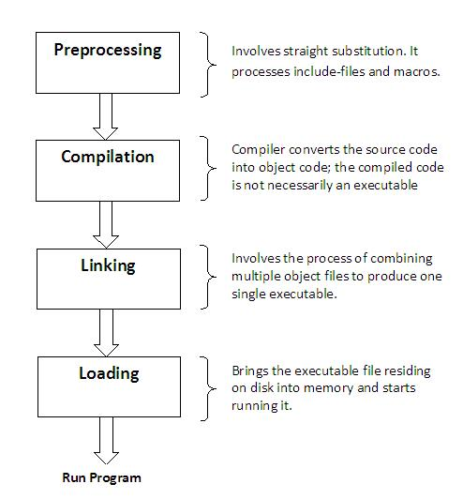
TRANSLATION FROM A SOURCE FILE TO AN EXECUTABLE FILE

Slide 6
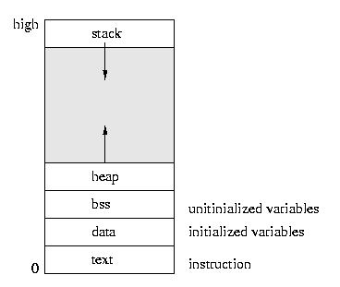
PROCESSES IN MEMORY
The text area holds the program code.
The data area holds global and static variables that must be stored in the executable, since they are initialized. It also holds uninitialized global data
The bss area holds variables that are uninitialized static data in the sense that their need not be persistently stored on disk -- they can be plugged in later.

Slide 7
USING GCC COMPILER
The C program on Linux can be compile using gcc command line.
1) Verify the gcc program is install on your Linux box.
[root@fedora ~]# gcc --version
gcc (GCC) 4.3.0 20080428 (Red Hat 4.3.0-8)
Copyright (C) 2008 Free Software Foundation, Inc.
This is free software; see the source for copying conditions. There is NO
warranty; not even for MERCHANTABILITY or FITNESS FOR A PARTICULAR PURPOSE.
2) Locate your c program code... usually have the filename end with .c, or Create a simple example of c program code:
[root@fedora ~]# vim mycprogram.c
#include <stdio.h>
int main(void){
printf("My first C program\n");
return 0;
}
3) To compile C program myprogram.c, and create an executable file :
$ gcc –o myprogram myprogram.c
OR
$ cc –o myprogram myprogram.c
To execute program myprogram, enter:
$ ./myprogram

Slide 8
Common gcc options:
  gcc -E :preprocessor
  gcc -S :create or show assembly coding
  gcc -o :object filename
  gcc -g :debug info
  gcc -O :optimized code
  gcc -Wall :create or show all warning
Using gdb for debugging
  Starting GDB: gdb name-of-executable
Commands used within GDB:
  help List gdb command topics.
  info breakpoints List breakpoints
  info break List breakpoint numbers.
  delete Delete all breakpoints.
  continue Continue executing until next break point
  step Step to next line of code. Will step into a function.
  list List source code.
  run Start program execution from beginning of the program.
  continue Continue execution to next break point.
  kill Stop program execution.quit
  q Exit GDB debugger.

Slide 9
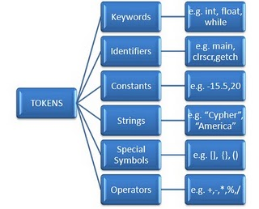
TOKEN'S OF C LANGUAGE

Slide 10
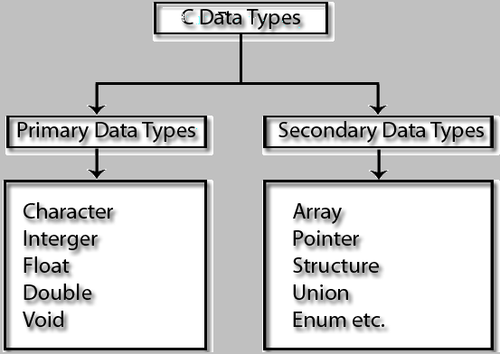
C DATA TYPES

Slide 11
PRIMARY OR BASIC DATA TYPES
Data type | Description | Typical memory requirements
Char | single character byte | 1
Unsigned char | non-negative character | 1
Short | Reduced precision integer | 1 or 2 bytes
Unsigned short int | Non negative reduced precision integer | 1 0r 2 bytes
Int | Integer | 2 bytes
Unsigned int | Non negative integer | 2 bytes
Long | Extended precision integer | 4 bytes
Unsigned long | Non negative extended precision integer | 4 bytes
Float | Floating point | 4 bytes
Double | Extended precision floating point | 8 bytes
Long double | Extended precision floating point | 10 bytes
Void | No type used for denoting 1) no return value from function 2) No argument of function 3) General pointer base

Slide 12
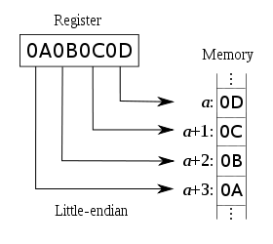
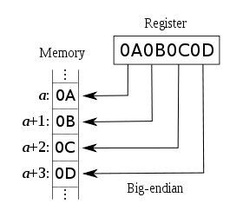
ENDIANESS : IF THE SIZE OF DATA TYPE IS MORE THAN ONE BYTE THEN ENDIANESS DECIDES THE MEMORY REPRESENTATION OF DATA TYPE . THERE ARE TWO TYPE OF ENDIANNESS.
Little Endian
Big Endian
The processor which follow the following memory representation of data is known as little-endian processor.
Example of processor: 8085,8086,8088,80286,80386,p1,p2 etc.
The processor which follow the following memory representation of data is known as big-endian processor.
Example of processor: Motorola, IBM PC etc.

Slide 13
STORAGE CLASSES IN C
Storage class | Declared | Can be referenced | Initialised with | Notes
Static | Outside fn Inside fn/b | Anywhere in file Inside fn/b | Constant expr Constant expr | 1 1
Extern | Outside fn Inside fn/b | Anywhere in file Inside fn/b | Constant expr Cannot be initialised | 2 2
Auto | Inside fn/b | Inside fn/b | Any expr | 3
Register | Inside fn/b | Inside fn/b | Any expr | 3,4,6
(omitted) | Outside fn Inside fn/b | Anywhere in file or files with ext. declaration. Inside fn/b | Constant expr. Any expr | 5 3,6
Notes:
1) initialized at start of program execution, default is zero
2) variable must be defined only in one place without extern
3) variable is initialized each time fn/b is entered, no default value.
4)register assignment not guaranteed, & operator cannot be applied.
5) variables can be declared in only one place, initialized at start of program execution, default is zero.
6) Default is auto

Slide 14
OPERATORS IN C
Operator Type | Operator | Example | Associativity
Primary Expression Operators | () [] . -> expr++ expr-- | Sqrt(x) Values[10] Mystruct.mem Mystructptr->mem Ptr++ Count-- | left-to-right
Unary Operators | * & + - ! ~ ++expr --expr (typecast) sizeof | *ptr &x +a -a !ready ~077 ++ptr --count (float) total/N Sizeof var | right-to-left

Slide 15
OPERATORS IN C
Operator Type
Operator
Example
Associativity
Binary Operators
*
/
%
i*j
i/j
i%j
left-to-right
+
-
Value + I
X -100
>>
<<
Byte >> 4
Value << 3
<
>
<=
>=
i < 100
i > 0
i <=100
i >=100
==
!=
Result == 0
C !=EOF
&
Word & 077
^
Word1 ^ word2
|
Word | bits
&&
J>0 && k<100
||
i>80 || ready

Slide 16
OPERATOR IN C
Operator Type | Operator | Example | Associativity
Ternary Operator | ?: | a>b:a:b | right-to-left
Assignment Operators | = += -= *= /= %= >>= <<= &= ^= |= | Count+=2 Same as count = count+2 | right-to-left
Comma operator | , | i=10,j=5 | left-to-right

Slide 17
FORMATTED INPUT OUTPUT
Scanf (“control string”, arg1, arg2, arg3 ………….argn);
Format field: %[size]type
  The format field is specified by the control string and the arguments.
  arg1, arg2, …………….argn specifies the address of location where data is to be stored.
  Size: is a number specifying the maximum size of the field.
  Type: specifies the type of value to be read
Printf (“control string”, arg1, arg2, arg3 ………….argn);
Format field: %[size][.prec]type
  Where format field is a character string describing how arg1,arg2,. . . . . .,argn are to be printed
  Size: is a number specifying the minimum size of the field.
  Prec: is the minimum no. of digits to display for int, number of decimal places for e and f.
  Type: specifies the type of value to be displayed

Slide 18
CONVERSION SPECIFIERS
  %c – Print a character
  %d – Print a Integer
  %i – Print a Integer
  %e – Print float value in exponential form.
  %f – Print float value
  %g – Print using %e or %f whichever is smaller
  %o – Print actual value
  %s – Print a string
  %x – Print a hexadecimal integer (Unsigned) using lower case a – f
  %X – Print a hexadecimal integer (Unsigned) using upper case A – F
  %a – Print a unsigned integer.
  %p – Print a pointer value
  %hx – hex short
  %lo – octal long
  %ld – long

Slide 19
STATEMENT SUMMARY (LOOPING)
The While Statement
The Break Statement
while (test condition)
{
body of the loop
}
Terminates execution of
for, while, do while or switch
statements.
break;
The do While Statement
The Continue statement
do
{
statement;
} while(expression);
skips statement that
follows in a do, while, for
then continues executing
the loop
continue;

Slide 20
STATEMENT SUMMARY (LOOPING)
The for Loop:
for (initialization; test condition; increment)
{
body of the loop
}
Evaluates expression1 once, then repeatedly
Evaluates expression2, body of the loop and expression3 in order. Until expression2 is false.
Expression2 ==1 is assumed if ommited
Ex: for(i=1;i<=10;i++)

Slide 21
STATEMENT SUMMARY
(DECISION MAKING - BRANCHING )
if Statement
The if else construct
if (condition)
{
statements;
}
if condition is true, then
executes statements;
otherwise skip it.
if(condition)
{
Statements block1
}
else
{
Statements block2
}
If condition is true, then
executes statements block1
else executes statements
block2

Slide 22
STATEMENT SUMMARY
(DECISION MAKING - BRANCHING )
goto label: Branches to statement preceded by label, which must be in the same function.
Ex:
int fn(void)
{
……
goto write;
…….
write:
printf(“Hello world”);
…….
}

Slide 23
STATEMENT SUMMARY (DECISION MAKING - BRANCHING )
switch(expr)
{
case const1:
……
break;
case const2:
……
break;
……..
default:
statement
break;
}
Expr must be an integer expression is evaluated & then compared against integer constant expression const1,const2,…..
If a match found, then the statement that follows the case (upto next break) will be executed
If no match found then the statements in the default case is executed.

Slide 24
PREPROCESSORS STATEMENTS
#define id text
  text is substituted for id wherever id later appears in the program.
  Ex: #define BUFFERSIZE 512
  If construct id(a1,a2,…..) is used, arguments a1,a2,….. will be replaced where they appear in text by corresponding arguments of macro call.
  Ex: #define max(A,B) ((A)>(B)?(A) : (B))
Means that x =max(p+q,r+s)
macro will be substituted for
x = (p+q)>(r+s)?(p+q) : (r+s)

Slide 25
PREPROCESSORS STATEMENTS
#undef id removes defination of id
………………………………………………..
#if expr if constant expression is true,
……. statements upto endif will be processed, otherwise they will not be.
#endif
………………………………………………..
#if expr if constant expression is true,
……. statements upto else will be
else processed, otherwise those between ……. else & endif will be processed.
#endif

Slide 26
PREPROCESSORS STATEMENTS
#include<file>
  inserts contents of file in program; look only in standard places
#include”file”
  Inserts contents of file in program; look first in same directory as source program, than in standard places

Slide 27
It’s the beginning……………
Explore as much as u can……

